Slide 1

Teaching Code with Minecraft
By: Dameesh Kumar, Hunter Kelsey, Bryn Caron, Ian Ssuna, Jiameng Zhou

Slide 2

Project Scope
Learning how to code with some fun!
15+ kids
Teaching ComputerCraft, Python, and RedStone
Creating a curriculum for the languages

Slide 3
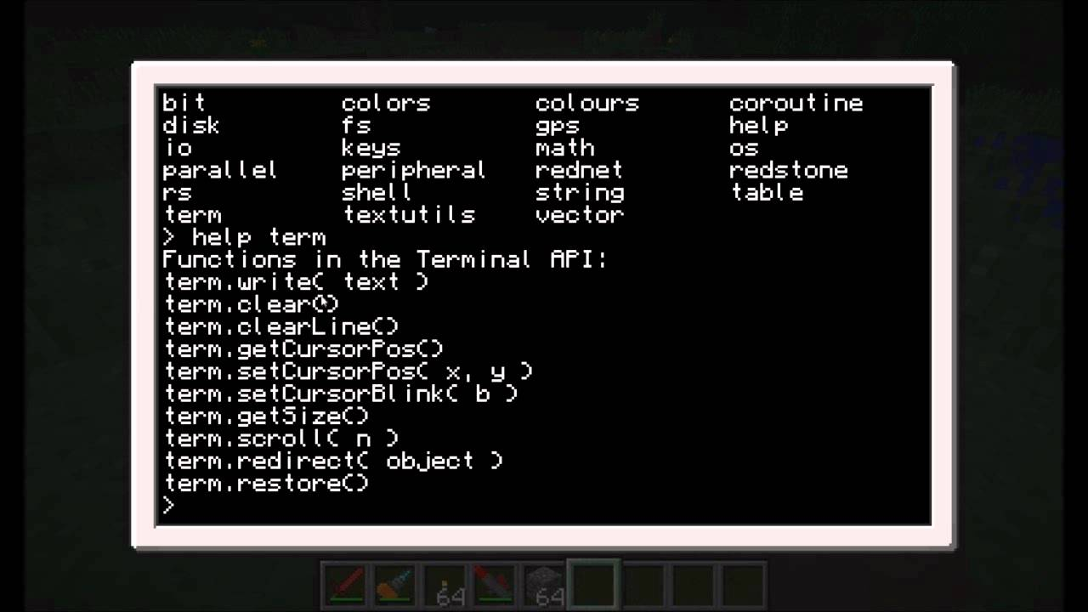
ComputerCraft
LUA programming
Compatibility issues

Slide 4
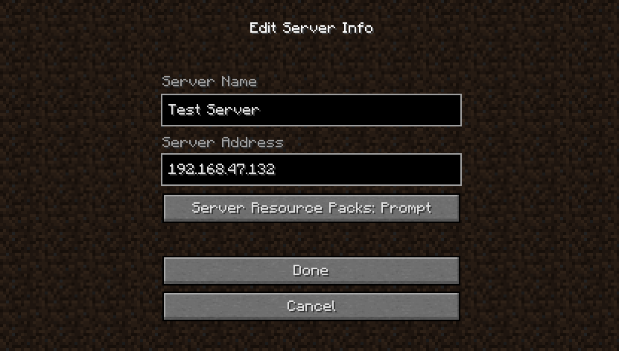
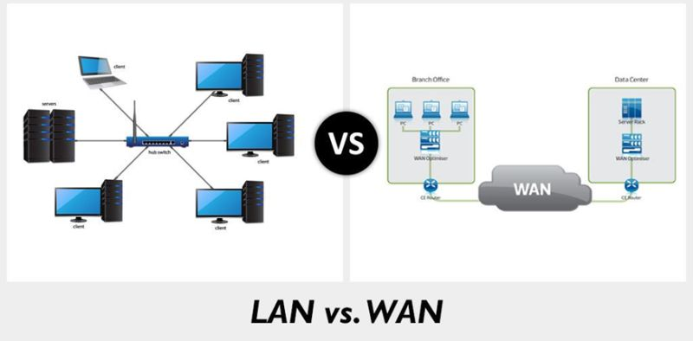
Server
Server capacity of 15 Player
LAN or WAN？

Slide 5
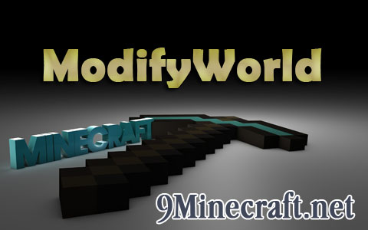
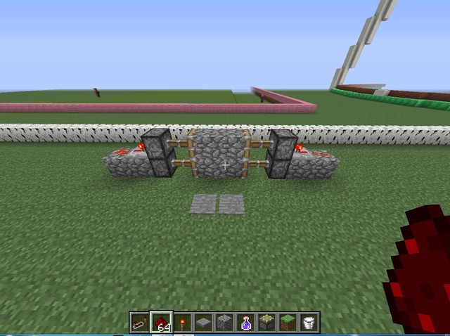
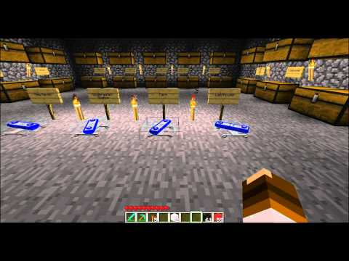
Mods and Redstone
Modifyworld Mod allows the admin to have control over who can delete and create in the world and other fine tuning admin tools.
Team Fortress 2 Teleporter mod
Redstone projects creating doors, complex piston doors, TNT launcher, flashing lights, ect

Slide 6


PyCraft
Compatibility testing
Programming with python

Slide 7
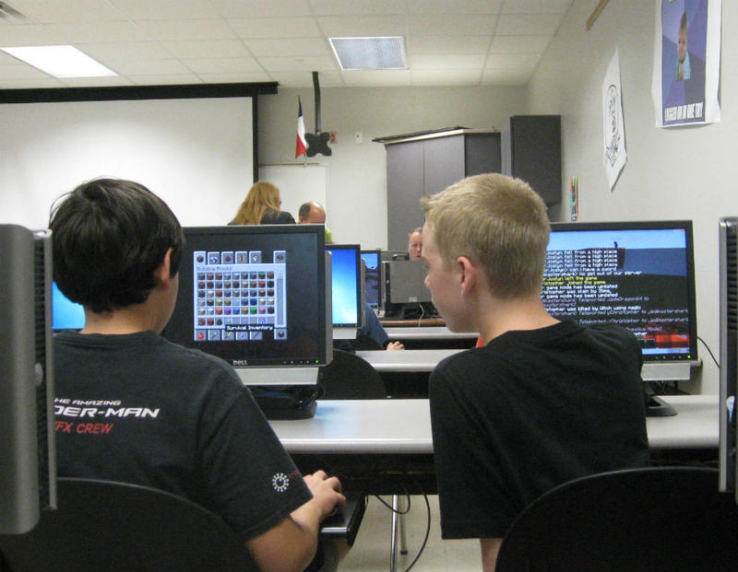
Curriculum
Develop 3 different curriculums
Computer craft
Pycraft
Redstone

Slide 8
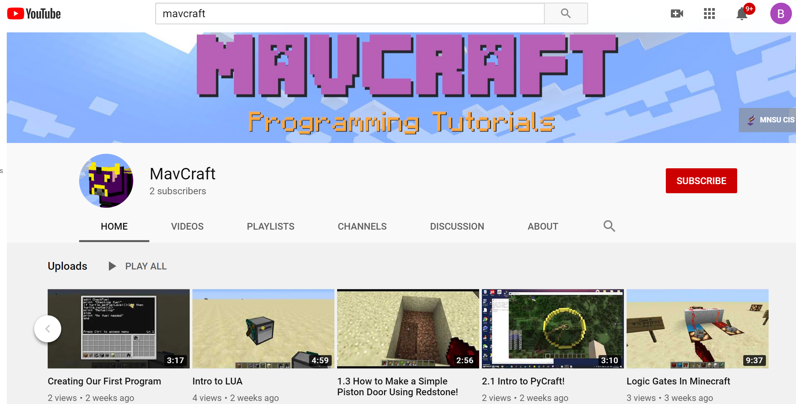

Slide 9
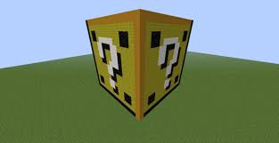
Questions

